Slide 1
Packet Traffic Generator
Neelan Joachimpillai
Packet Format
entity traffic_generator is
generic(source_size : integer := 4;
destination_size : integer := 4;
timer_size : integer := 56;
startbit_size : integer := 1);
By changing these values, you can change the size of the fields of the packets generated. After these values are changed you just recompile the code, and the traffic generator will be adjusted so that it generates new sized packets.

Slide 2
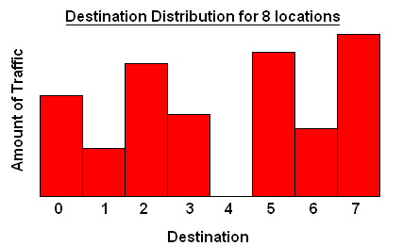
Configuration Options
Destinations can be biased any way you want.
You can turn of specific sources if you do not wish for them to generate traffic.
- Generator is connected to a processor that allows added functionality.
You can make the variables of the traffic generator change dynamically by writing software processor code. This can cause added variations. For further instructions on how to do this refer to the documentation.
Many types of traffic can also be generated if wished. (i.e. pareto, non-uniform, uniform)

Slide 3
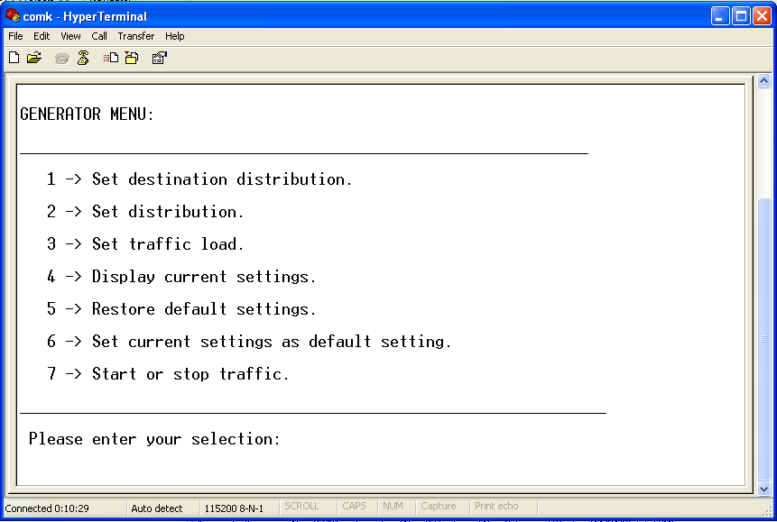
Controlling the Traffic Generator
Communication with the FPGA is done via hyper terminal.
Then any changes wanted while the traffic generator is running can be done via the UI in hyper terminal.

